Slide 1
CAPSTONE PROJECT ZOMATO OPERATIONS ANALYTICS FOR METROPOLITAN CITIES
By
Noel John Robert

Slide 2
PROBLEM OVERVIEW
To create a comprehensive Data Pipeline using Azure Data Factory & Azure Databricks and create a dashboard for Zomato Operational Analytics in Metropolitan cities and derive useful insights.

Slide 3
Data Sources
Metropolitan delivery dataset -> HTTP Source
Delivery Operational Analytics dataset -> Azure Blob, SQL Table

Slide 4
SOLUTION FLOW DIAGRAM
Tech Stack:
Data Storage -> Azure Blob Storage, Azure SQL DB
Landing Zone -> CosmosDB
Data migration and Transformation ->Azure Data Factory
Data Transformation and Aggregation -> PySpark
Querying -> SparkSQL
Visualization -> Azure Databricks

Slide 5
SOLUTION FLOW
Pipeline
Data Ingestion
Landing Zone (CosmosDB)
Data Cleaning (using PySpark)
Data Processing (using PySpark)
Data Analysis (using SparkSQL)
Data Visualization (using Databricks)

Slide 6
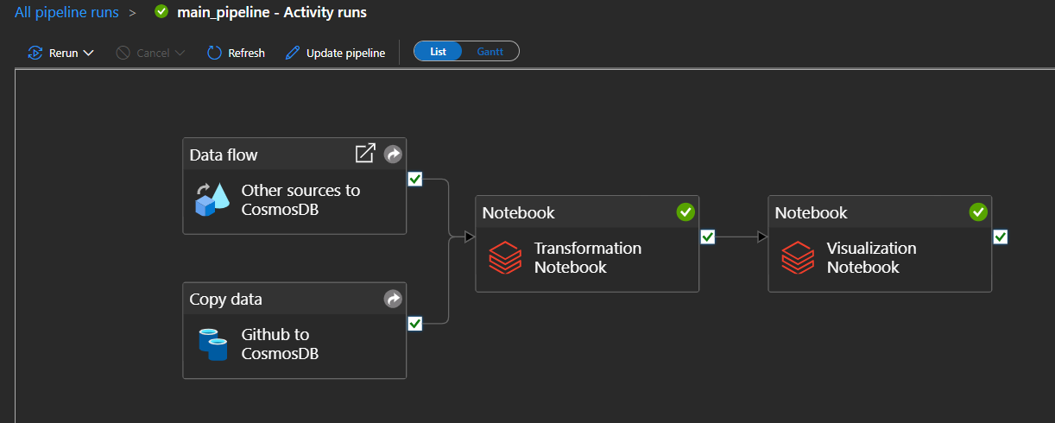
SOLUTION FLOW
Pipeline Runs

Slide 7
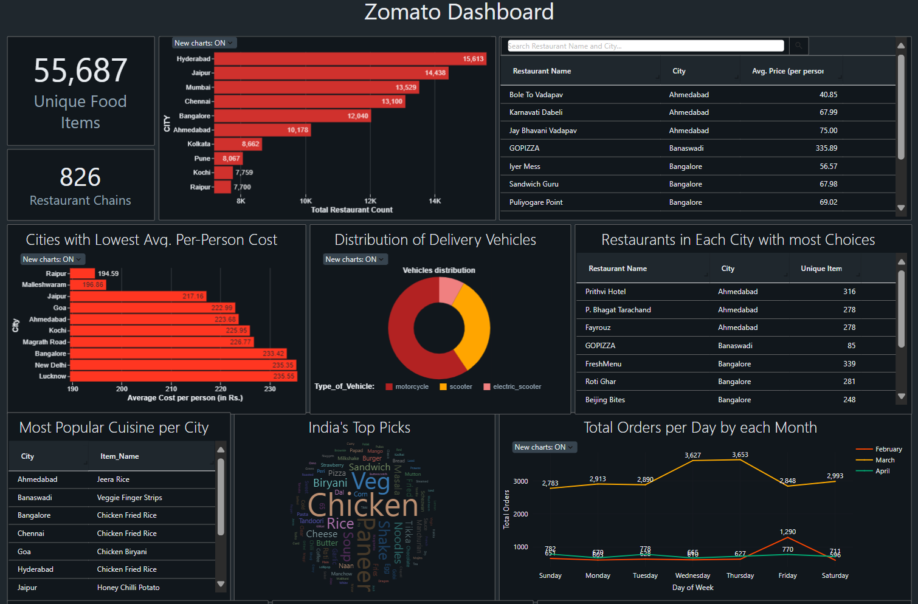
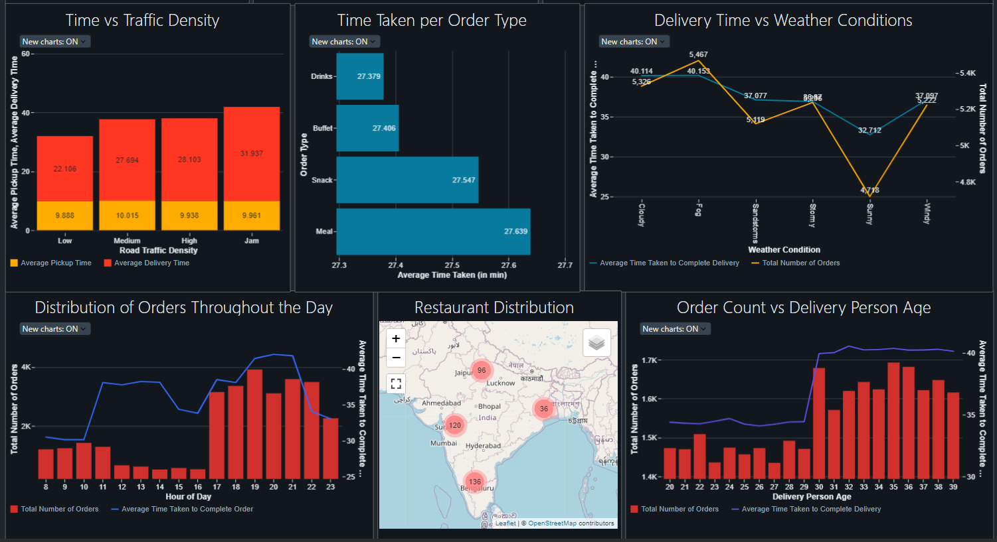
OUTPUT
Dashboard

Slide 8
INSIGHTS
Total number of orders for March is much higher than that for February and April
Most listed items are chicken items, followed by vegetarian items.
Number of orders is much lesser during ‘Sunny’ weather, and average time taken is also lesser during this weather.
Throughout the day, most volume of orders are between 17:00 to 23:00 and highest is at 19:00.
Delivery agents above the age of 30 years deliver the most number of orders, and they also take much longer to complete the delivery.

Slide 9
THANK YOU

